Slide 1

Introduction to PDO development processes
ÅF-PDOQ-054 v2018-09-28; Sofia Hellman

Slide 2
PDO West Wiki
https://one.afconsult.com/units/professional/Embedded In-house West/WIKI PDO Embedded West/Home.aspx
Always check here before you ask – a lot of PDO West specific information can be found here
Contains
General PDO West Guidelines
Abbreviations and terminology
Document templates
Embedded West professional service categories
Project lessons learned
PDO Development Tools
Compliant standards
PDO office space
PDO ordering gadgets, devices and thingies
How to send parcels and packages
New resources at PDO
PDO Vacation List
Development processes at PDO Embedded West
Information for consultants between assignments

Slide 3
Standard Compliance
https://one.afconsult.com/units/professional/Embedded In-house West/WIKI PDO Embedded West/PDO West Standard Compliance.aspx
Automotive SPICE
Current development accordingly
Main standard for the PDO work processes
ISO26262
Current development accordingly
Aim to include this in the PDO work processes
MedTech standards
Special SOPs have been developed for this
Education within Medtech when needed for project
Customer specific standards
Requirements from customer to comply to other standards
Cooperation with other ÅF departments with knowledge within these standards
VALID STANDARS AND PROCESSES FOR EACH PROJECT ARE STATED IN PID (Project Initiation Document)

Slide 4








PDO tooling
https://one.afconsult.com/units/professional/Embedded In-house West/WIKI PDO Embedded West/PDO Development Tools.aspx
PDO has a number of development tools which are used within the projects:
Tool | Area | Description
 | HW | The preferred PCB design tool at PDO
 | SW | Used as GIT tool as part of the CI review chain for SW
 | SW | Used for automatic reviews in the SW review chain
 | General | General project tool used for sprint and time planning as well as for issue and change management
- | Requirements, verification | Add-on in JIRA for requirement and test case management
LTSpice | HW | Used for simulations of hardware and electrical circuits
- ÅF ONE for projects | General | The ÅF SharePoint where unit sites are created for all projects
 | HW | PCB design tool which may be used if requested by client/customer

Slide 5
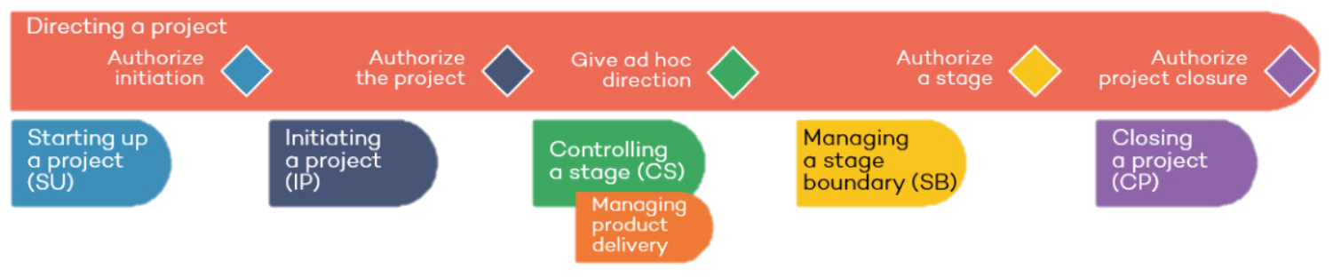
ÅF Project Model
https://afonline.sharepoint.com/sites/ProjectModel/Pages/Startpage.aspx
Based on PRINCE2
All PMs shall at least perform the courses “Introduction to ÅF project model – e-learning” och “Managing ÅF Projects – class room”: https://afacademy.litmos.com/course/602419?r=False&ts=636736265970990379 https://afacademy.litmos.com/course/646108?r=False&ts=636736265970990379
Preferrably also “PRINCE2® Foundation & Practitioner” https://afacademy.litmos.com/course/599020?r=False&ts=636736279545020426

Slide 6
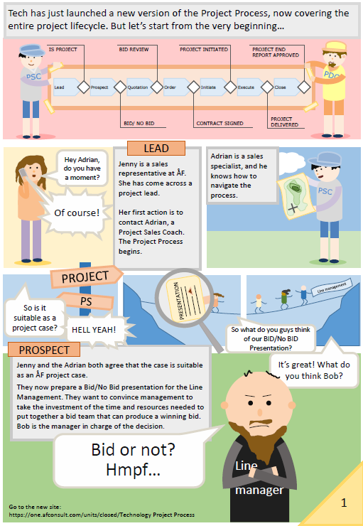
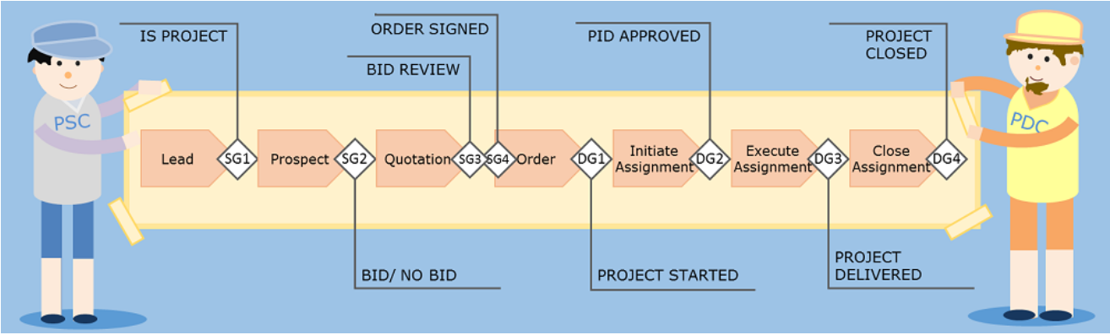
ÅF Technology Process
https://one.afconsult.com/units/closed/Technolog Project Process/web/Index.html#process-overview-intro
Adaption of ÅF Project Model to Digital Solutions
Guidelines and templates
Website introduction
Stages
Governance
Tools
PDO
Development
Processes

Slide 7
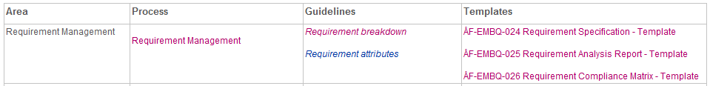
Process overview
https://one.afconsult.com/units/professional/Embedded In-house West/WIKI PDO Embedded West/PDO Embedded West Development processes.aspx
Four parts stated
Area – General information of the area, e.g. SW, HW, CM etc.
Process – the process it self
Guidelines – to support the work of fulfilling the processes with how to:s, additional information etc.
Templates – states templates used for that particular process

Slide 8
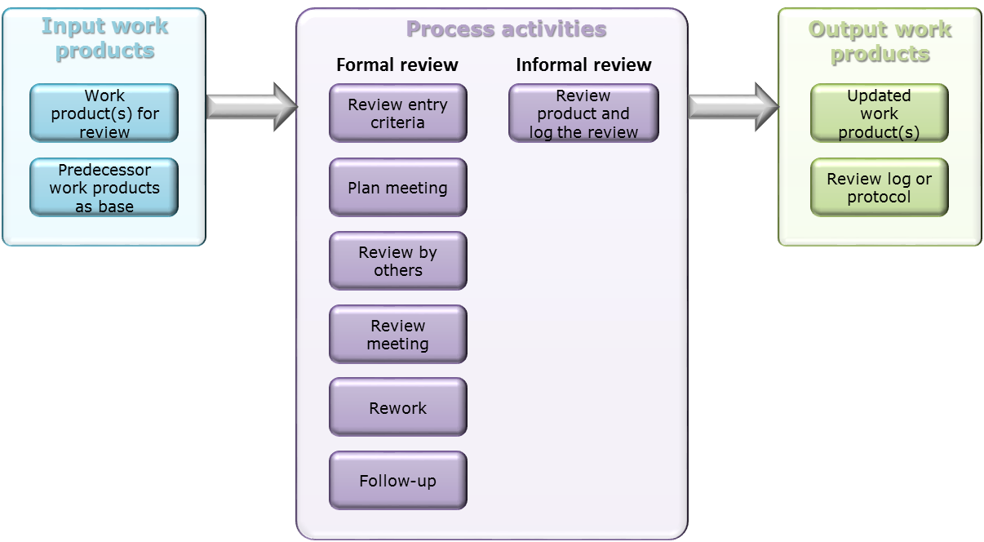
Review process
https://one.afconsult.com/units/professional/Embedded In-house West/WIKI PDO Embedded West/Review process v2.aspx
Key points:
Review shall be done by at least one other person than the author
All reviews shall be logged – even informal reviews (log that it occurred)
Review logs may be
Review protocols (template)
Comment in Jira issue
Comments in word/excel document
Comments via GIT/gerrit review (see later slide)
Logs shall be saved!

Slide 9
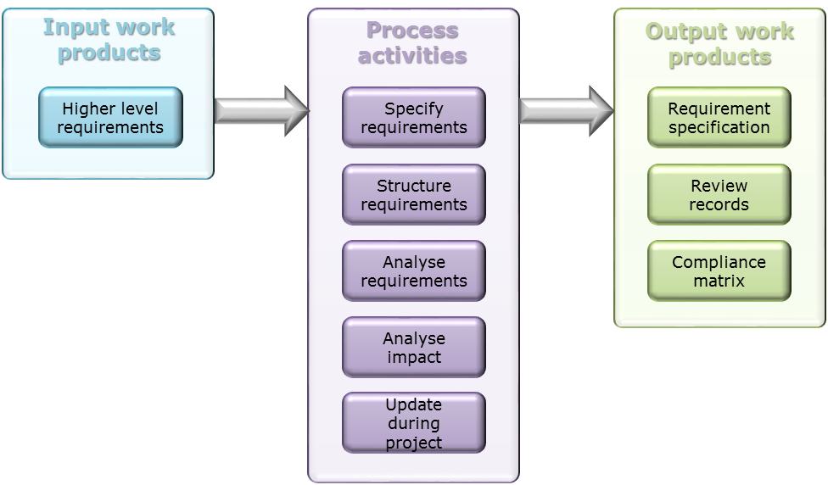
Requirement Management Process
https://one.afconsult.com/units/professional/Embedded In-house West/WIKI PDO Embedded West/Requirement management v3.aspx
All requirements shall include:
Unique requirement ID
Status
ID of parent requirement(s)
Minimum verification method
Compliance analysis of requirements
Applicable for the project
Complete
Clear and understandable
Verifiable
Adequate and feasible
Consistent
Structure by grouping, sorting and categorizing
Analyse impact on operating environment and interfaces
Requirement title
Requirement description
Origin

Slide 10
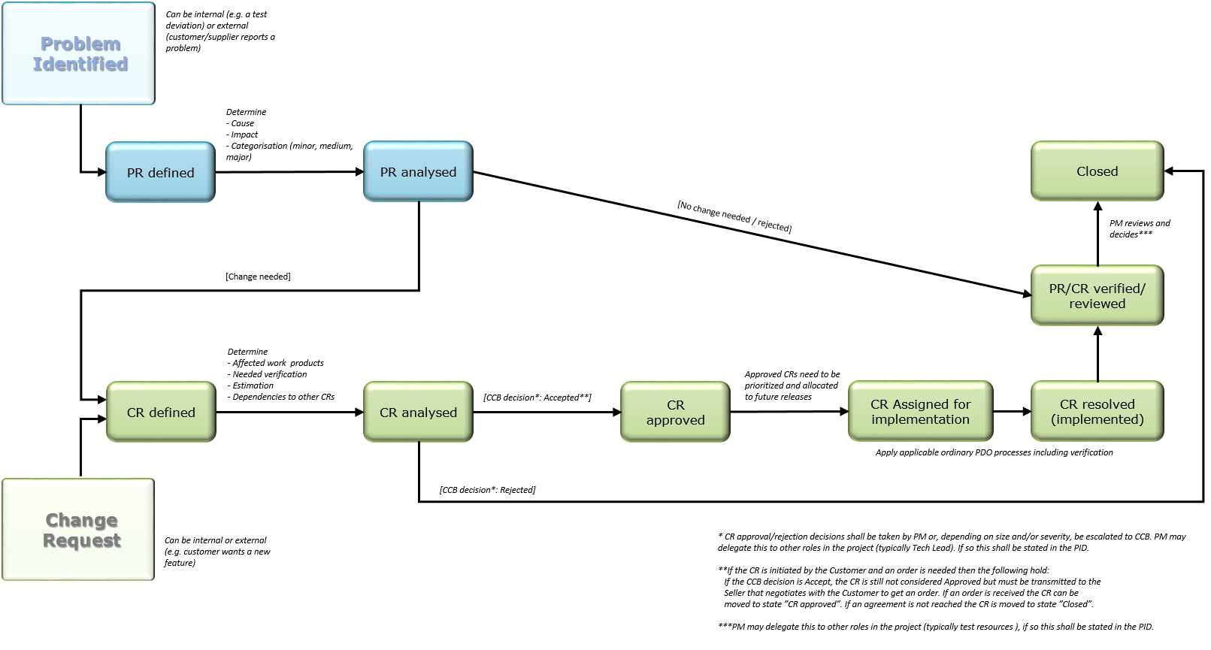
Problem Resolution and Change Request
https://one.afconsult.com/units/professional/Embedded In-house West/WIKI PDO Embedded West/Problem Resolution and Change Request Management process v1.aspx

Slide 11
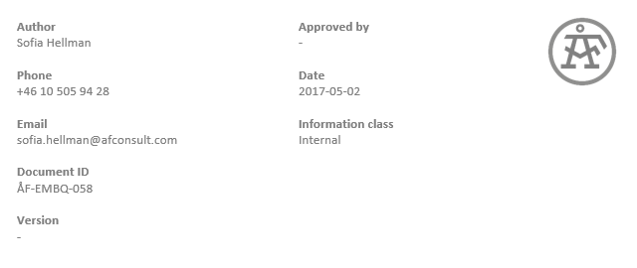

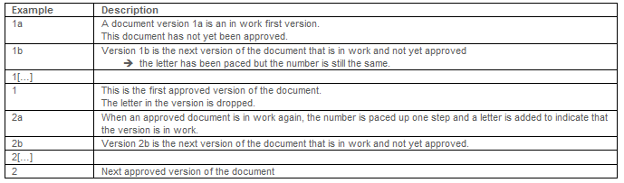
Document management Process
https://one.afconsult.com/units/professional/Embedded In-house West/WIKI PDO Embedded West/Document management v1.aspx
Project work product journal
All formal documents in the project shall be stated here
Document headers
Information Class
Internal, project internal, limited internal
Document version numbering
Document ID and file naming convention
Also include all references, version history and abbreviations/terminology
ÅF-PDO-pxNumber-002 v1b ExampleProject Project plan
Document release
Review
State review level, review date and reviewed for that version by in document journal
State approver and approve date for that version by in document journal

Slide 12
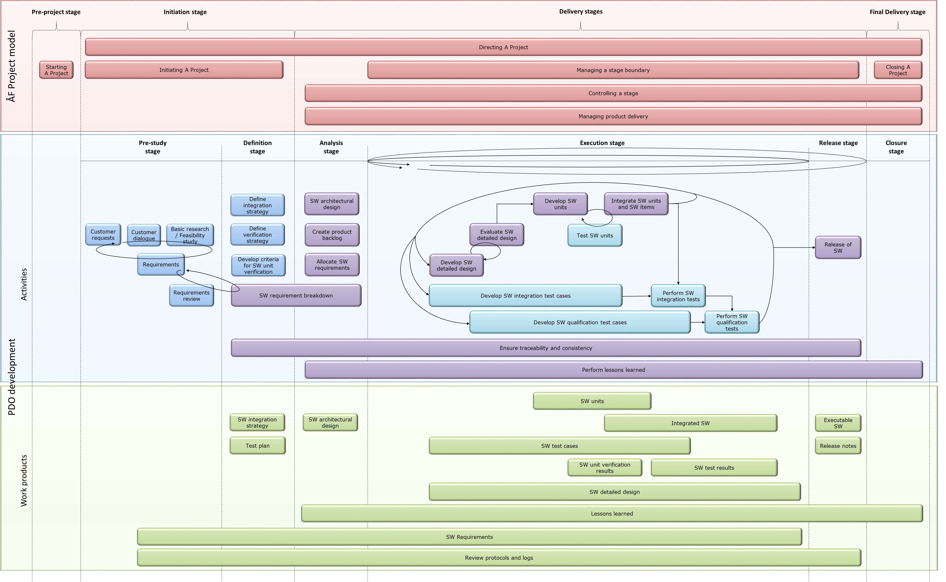
Process overview
https://one.afconsult.com/units/professional/Embedded In-house West/WIKI PDO Embedded West/Review process v2.aspx
Software Development Process

Slide 13
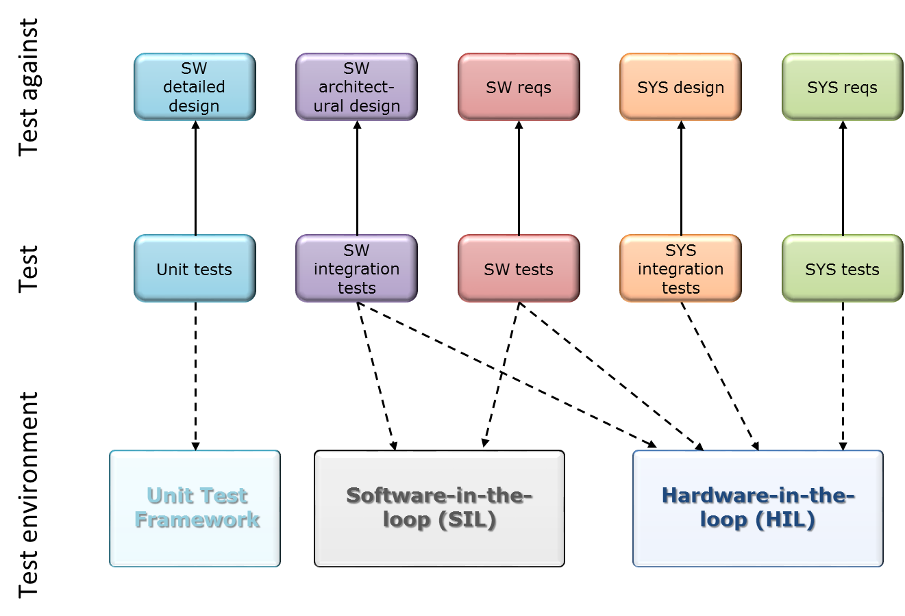
Verification and corresponding areas
Software Development Process

Slide 14
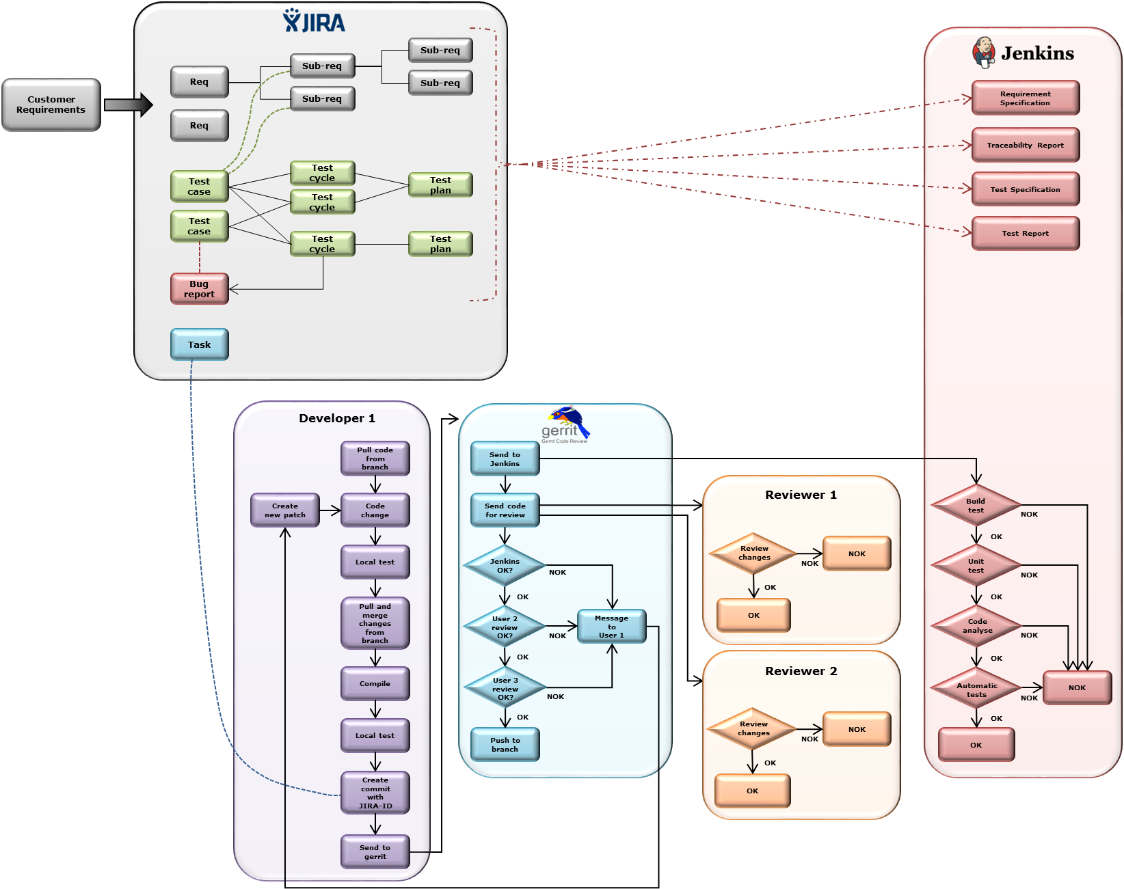
Continuous Integration
Software Development Process
Project work product journal
All formal documents in the project shall be stated here
Document headers
Information Class
Internal, project internal, limited internal
Document version numbering
Document ID and file naming convention
Also include all references, version history and abbreviations/terminology

Slide 15
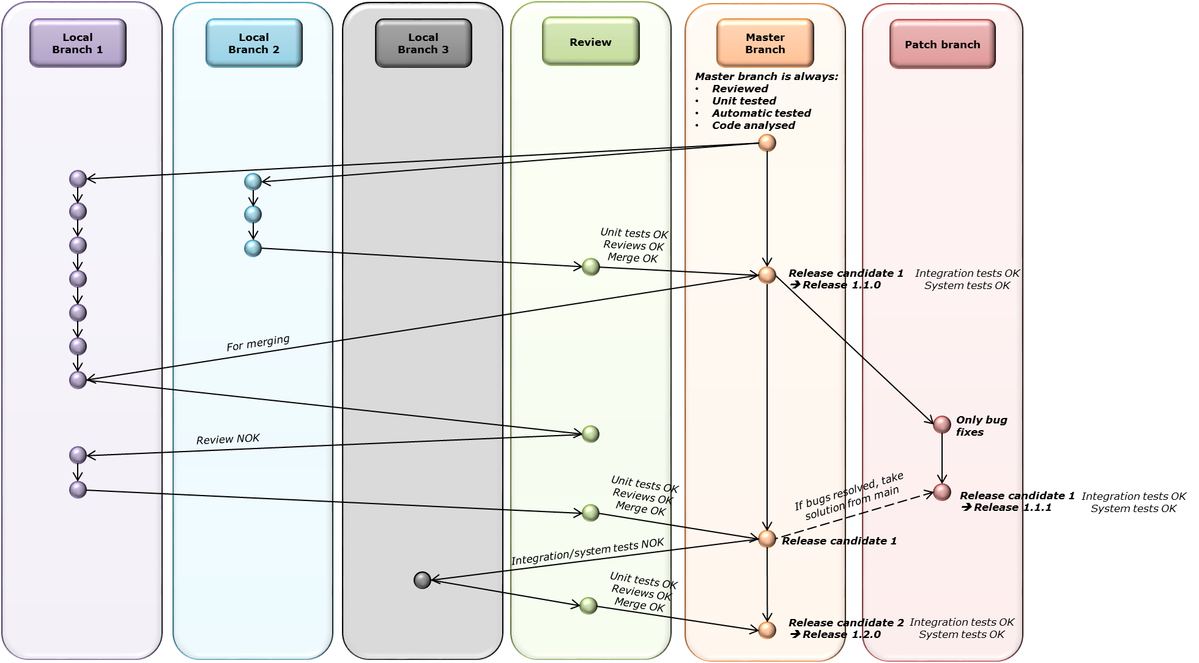
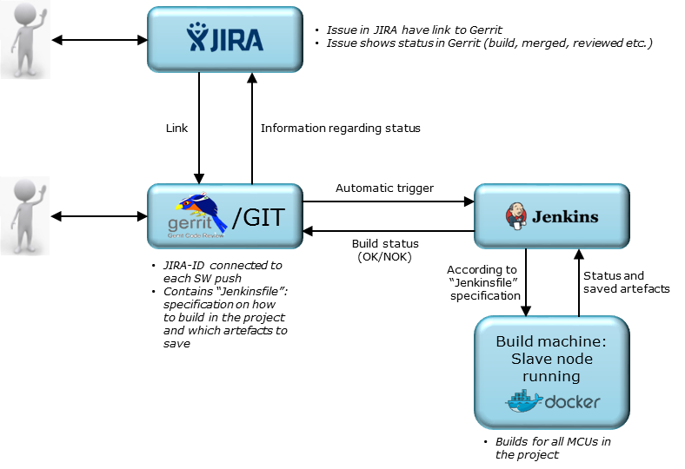
Continuous Integration
Software Development Process
SW build tool chain
SW branching

Slide 16
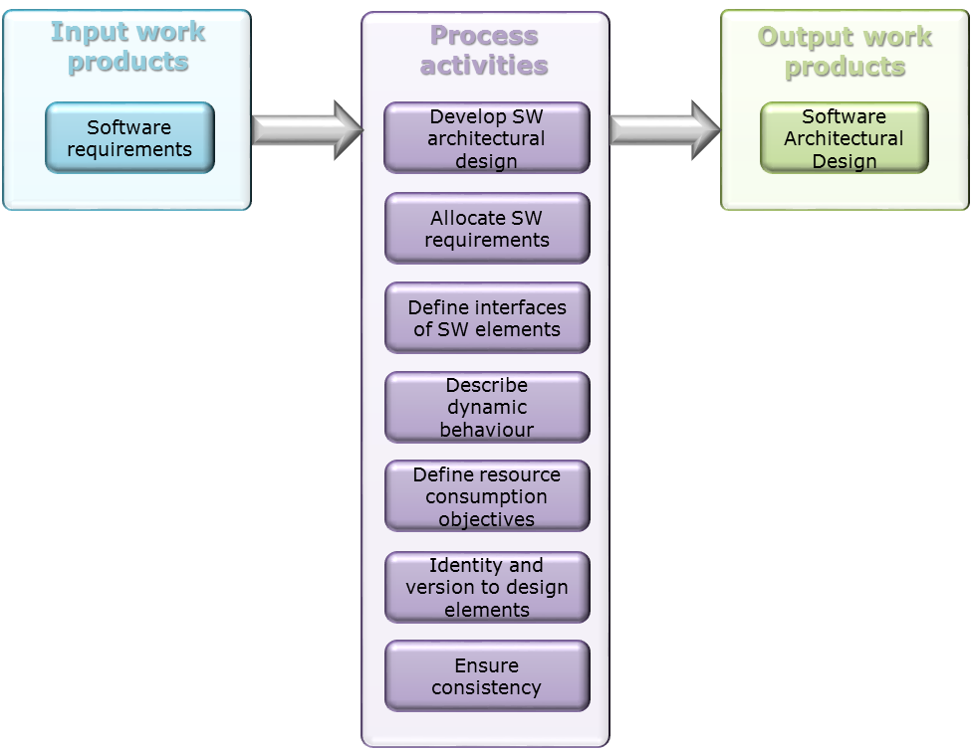
Software Architectural Design
https://one.afconsult.com/units/professional/Embedded In-house West/WIKI PDO Embedded West/SW Architectural Design v1.aspx
Software Development Process
Preliminary version before any source code is developed
Shall be updated continuously during development to match actual architecture
Each SW component shall have a section of its own
ID and versions to design elements for testing!
Perform 1/3 review of the architectural design
Definition design element:
May be any element mentioned in a design document
SW components, state diagrams, images showing interactions between two components etc.
There is a need to verify the interfaces and interactions between the integrated SW components against the SW design - hence verification against the design elements

Slide 17
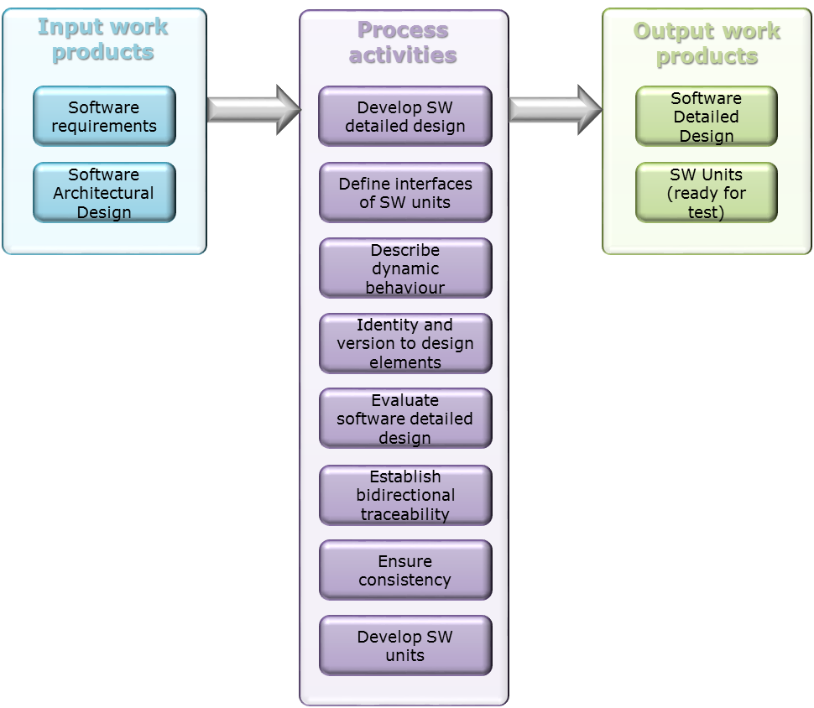
Detailed Design and Unit Construction
https://one.afconsult.com/units/professional/Embedded In-house West/WIKI PDO Embedded West/SW Detailed Design and Unit Construction v1.aspx
Software Development Process
Preliminary version of detailed design before any source code is developed
Shall be updated continuously during development to match actual software for each SW component
Document SW requirements/design elements implemented in the code
ID and versions to design elements for testing!
Evaluate and analyse the design
Naming convention
Coding guidelines when developing

Slide 18
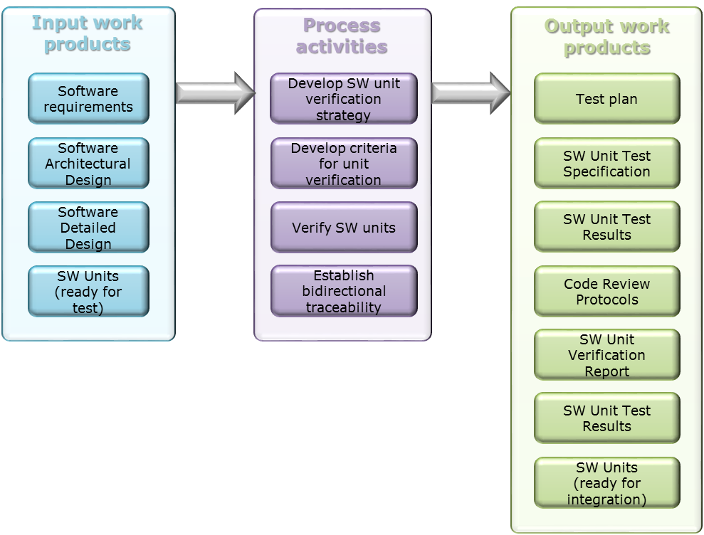
Unit Verification
https://one.afconsult.com/units/professional/Embedded In-house West/WIKI PDO Embedded West/SW Unit Verification v1.aspx
Software Development Process
Test plans (including strategies) developed early in project
Test cases to demonstrate compliance with detailed design according to strategy
Acceptance criteria
SW requirements/design elements tested
Textual description of the test case
Review TC before start of testing!
Verification
Document code reviews
Check resource consumptions
Document unit test results
Compilation report
KPI:s
Create deviation reports for all deviations found in the testing on the main branch!

Slide 19
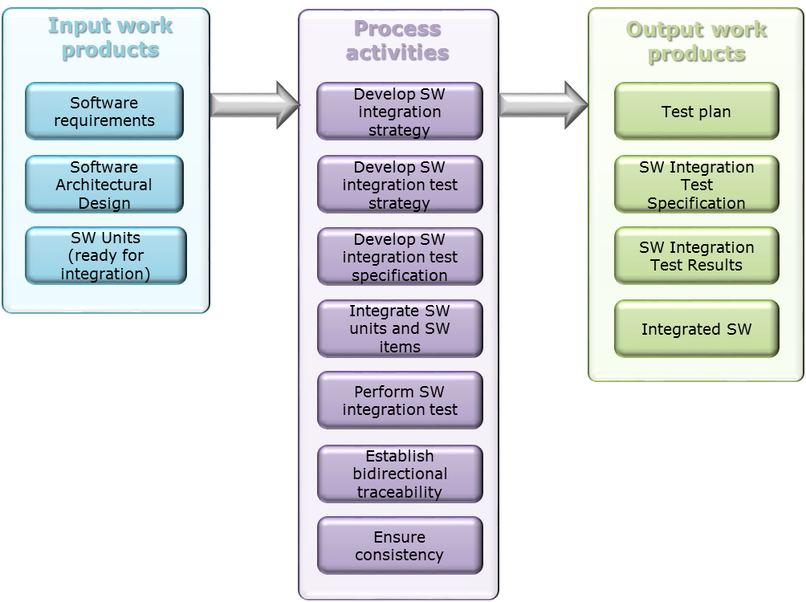
Integration and Integration Test
https://one.afconsult.com/units/professional/Embedded In-house West/WIKI PDO Embedded West/SW Integration and Integration Test v1.aspx
Software Development Process
Test plans (including strategies) developed early in project
What, how and when to test
Test cases to demonstrate compliance with architectural design
Test case ID
Objective
The IDs of the software requirements and/or design elements to which the test case demonstrates compliance
Inputs required to execute the test case
Step-by-step description of how to execute the test case
Expected output and behaviour
Test environment
Document test results
Create deviation reports

Slide 20
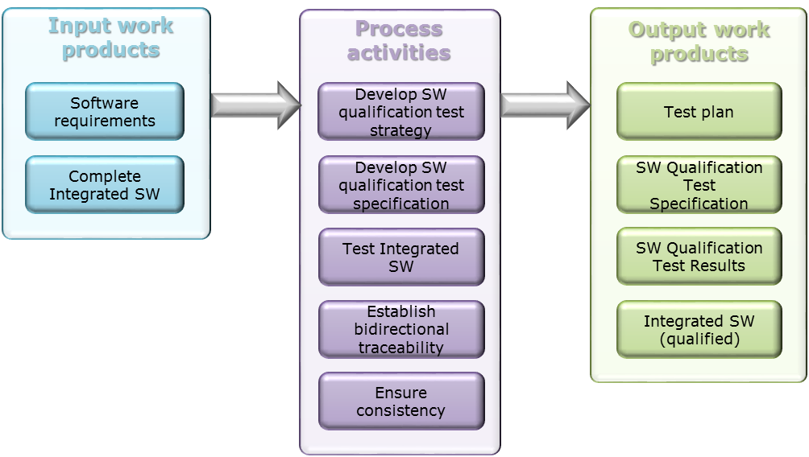
Qualification Test
https://one.afconsult.com/units/professional/Embedded In-house West/WIKI PDO Embedded West/SW Qualification Test v1.aspx
Software Development Process
Test plans (including strategies) developed early in project
What, how and when to test
Test cases to demonstrate compliance with requirements
Test case ID
Objective
The IDs of the software requirements to which the test case demonstrates compliance
Inputs required to execute the test case
Step-by-step description of how to execute the test case
Expected output and behaviour
Test environment
Document test results
Create deviation reports

Slide 21
Creation of test plans and test cases
https://one.afconsult.com/units/professional/Embedded In-house West/WIKI PDO Embedded West/SW Qualification Test v1.aspx
Software Development Process
Test plans (including strategies) developed early in project
What, how and when to test
One for each area or one for the entire project
Test cases to demonstrate compliance with requirements or design
Test case ID
Objective
The IDs of the software requirements to which the test case demonstrates compliance
Inputs required to execute the test case
Step-by-step description of how to execute the test case
Expected output and behaviour
Test environment
Managed in JIRA
Link requirements directly in JIRA
Step by step
Examples: SYTRAINING-9, SYTRAINING-13, Example test cycle 2

Slide 22
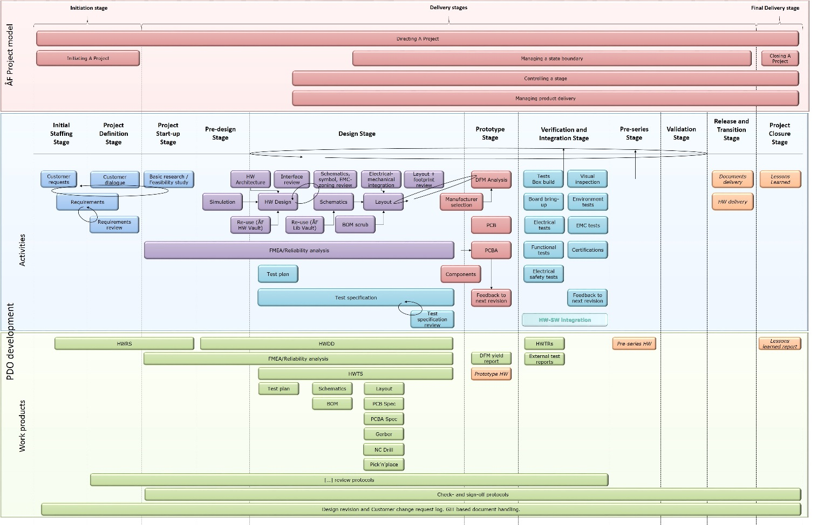
Process overview
https://one.afconsult.com/units/professional/Embedded In-house West/WIKI PDO Embedded West/Review process v2.aspx
hARDware Development Process

Slide 23
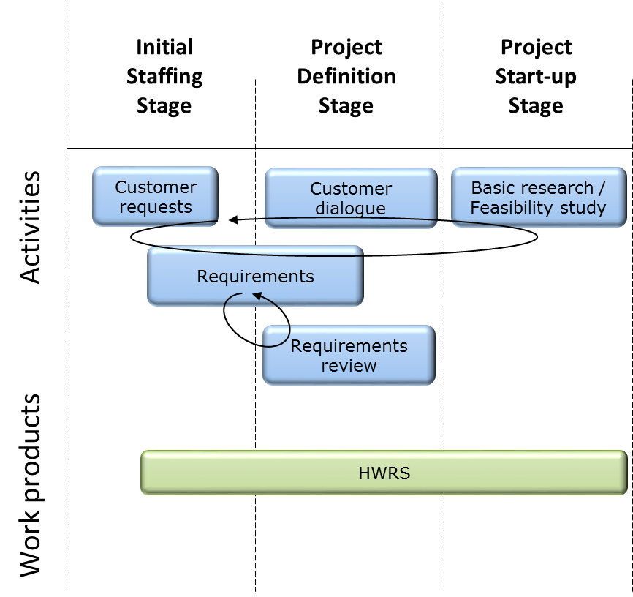
Pre-study
https://one.afconsult.com/units/professional/Embedded In-house West/WIKI PDO Embedded West/HW pre-study process v1.aspx
hardware Development Process
Understanding of customer requests
Preliminary requirement structure
Close dialogue with customer is of key importance
Understanding if the requests are feasible for development

Slide 24
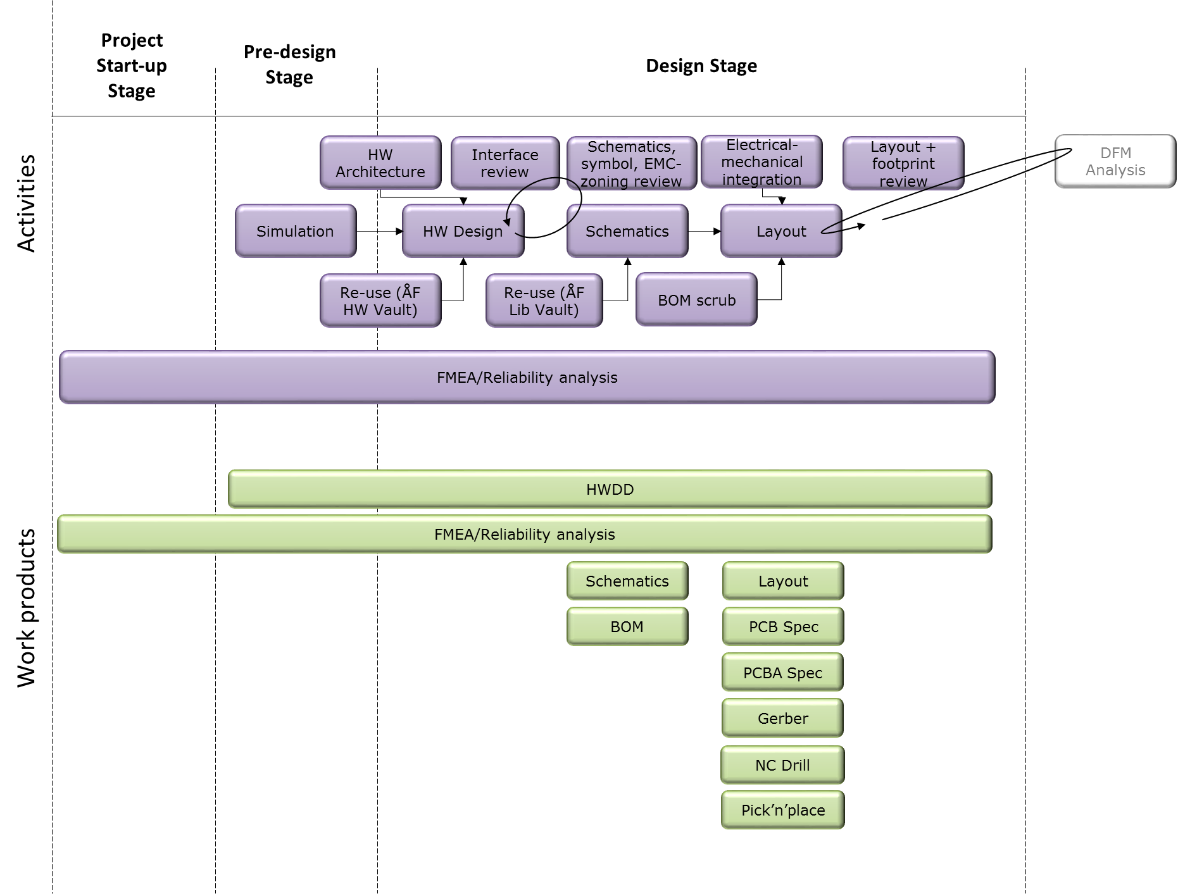
Hardware Design
https://one.afconsult.com/units/professional/Embedded In-house West/WIKI PDO Embedded West/HW design process v1.aspx
Hardware Development Process
All work products shall be reviewed by a person of correct competence and the reviews shall be logged
Re-use as much as possible
Review loops are important for all stages
Use checklists for help
Continuous update of Lessons Learned Log
FMEA – ensure consensus on the expected outcome
Define EMC-zones during schematics
Perform footprint reviews as well as layout reviews
A close cooperation between electrical and mechanical design teams during the PCB layout process is absolutely critical for time line

Slide 25
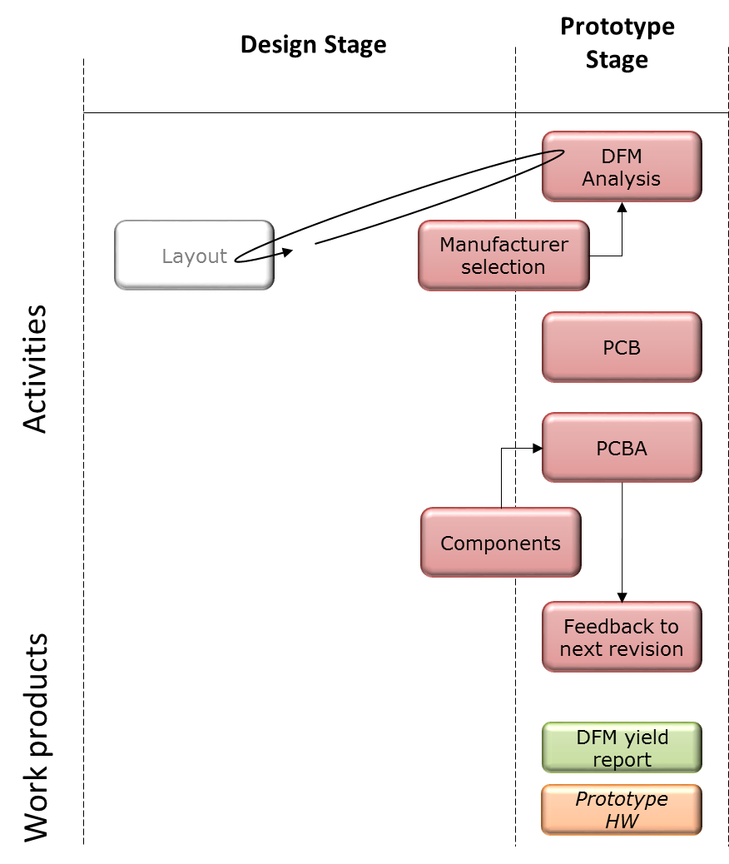
Manufacturing
https://one.afconsult.com/units/professional/Embedded In-house West/WIKI PDO Embedded West/HW manufacturing process v1.aspx
Software Development Process
Close cooperation with manufacturer during DFM analysis is important
Note all experiences in the Lessons Learned Log
Aim for same manufacturer for both prototypes and series production
Tight control of the manufacturer production status to get early warnings of time schedule deviations
PCBA
Cleaning of assembly
Gluing, underfill, conformal coating may be needed in hostile environments

Slide 26
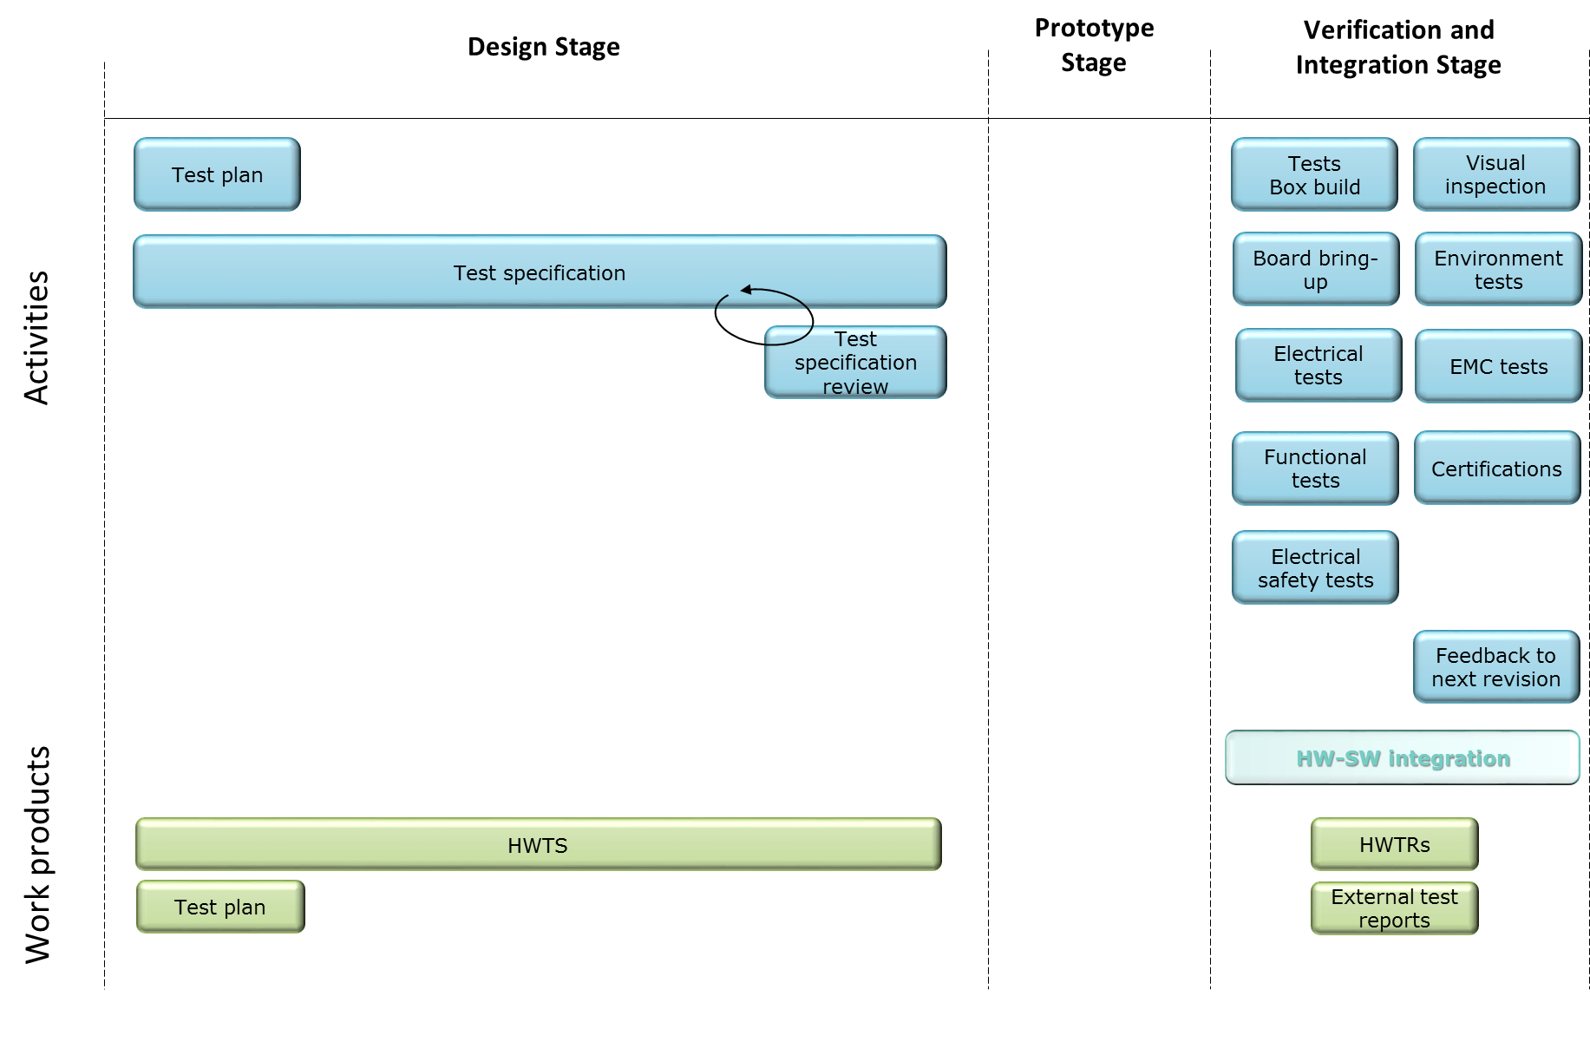
Verification
https://one.afconsult.com/units/professional/Embedded PDO Embedded West/HW verification process v1.aspx
HARDware Development Process
Test planning is done early
What, how and when
EMC? DV? Certifications?
Test specification reviewed and approved before start of test
Close dialogue with customer is of key importance
Different types of testing but same approach for test cases
External test reports shall also be stored
Do not forget to verify test equipment as well as the product!

Slide 27
Creation of test plans and test cases
https://one.afconsult.com/units/professional/Embedded PDO Embedded West/HW verification process v1.aspx
Hardware Development Process
Test plans (including strategies) developed early in project
What, how and when to test
One for each area or one for the entire project
Test cases to demonstrate compliance with requirements or design
Test case ID
Objective
The IDs of the software requirements to which the test case demonstrates compliance
Inputs required to execute the test case
Step-by-step description of how to execute the test case
Expected output and behaviour
Test environment
Managed in JIRA
Link requirements directly in JIRA
Step by step
Examples: SYTRAINING-9, SYTRAINING-13, Example test cycle 2

